Slide 1
Looking Past COVID-19: Membership
Chapter Leaders Meeting
Matt Molchany and James Rumph
ACFE Chapter Leaders Committee

Slide 2
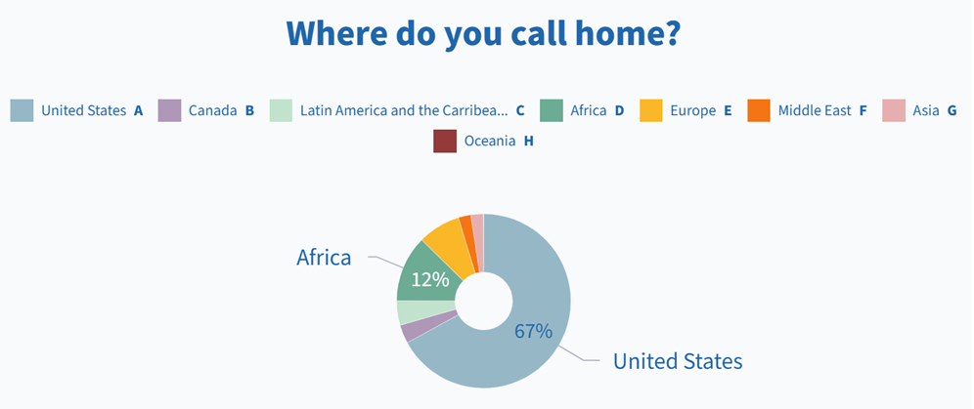

Slide 3
Agenda
Presentation/Discussion (10:00 – 11:00 AM CST)
  2020 Chapter Member Changes
  Catalysts to Membership Growth / Retention
  Pitfalls to Avoid Membership Decreases
  Dues Pricing
Roundtable Discussions (11:10 – 11:40 AM CST)
Discussion Recap (11:40 – 11:50 AM CST)
Tomorrow: Looking Past COVID-19: Events

Slide 4

2020 Chapter Member Changes
Average Increase: 24%
Chapter Growth Call-Outs:
WI - Milwaukee 291%
FL - South Florida 157%
Canada - Calgary 100%
TX - Rio Grande Valley 100%
NJ - New Jersey Area 68%
Average Decrease: 20%

Slide 5
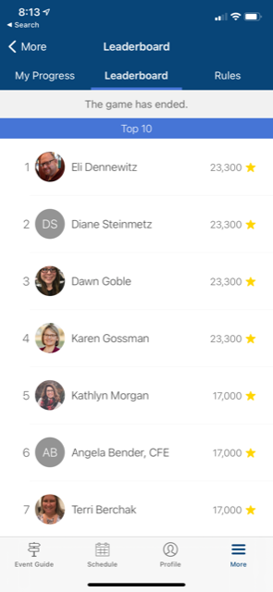
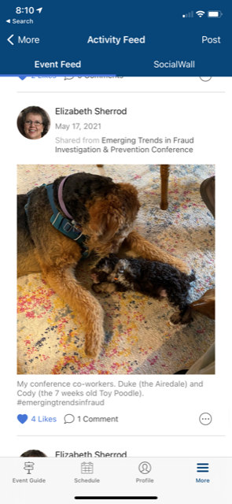


Catalysts to Membership Growth / Retention
Providing high quality events
Providing networking opportunities
Free memberships to new CFEs in market
Membership outreach
Flexible CPE offerings
Accreditation offerings
Member recognition (i.e. member spotlights, awards, lapel pins)
Giveaways (i.e., raffles, swag, and scholarships)
Notes:
James - 5

Slide 6
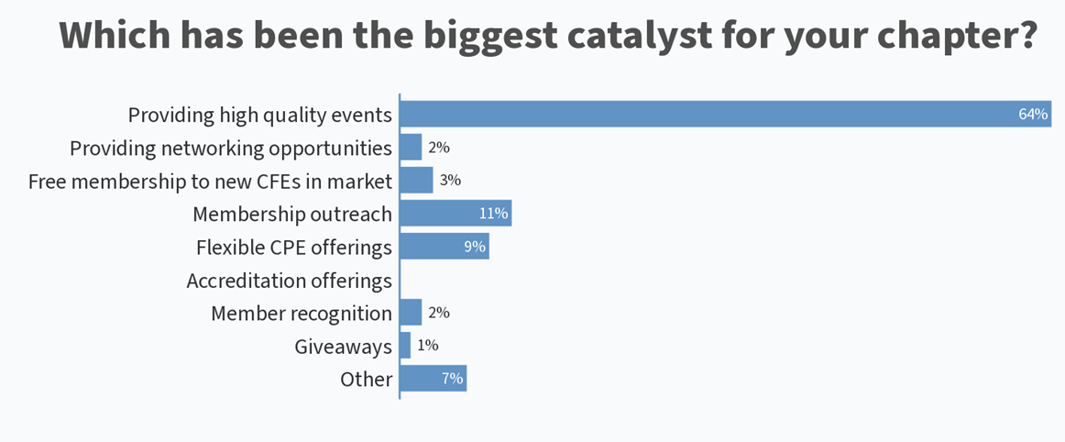

Slide 7
Pitfalls to Avoid Membership Decreases
Lack of CPE training
  How to fix: Chapter’s goal should be to provide a minimum of 20 CPE hours?
Ad-hoc training offerings
  How to fix: Holding CPE trainings on a consistent basis and providing advanced notice
Lack of Member Outreach
  How to fix: Is their other ways to connect to your members via LinkedIn, Facebook, Instagram?

Slide 8

Pricing Structures
No Dues
Nominal Dues
Mid-Level Dues
Package Dues

Slide 9

Georgia ACFE
Membership Levels

Slide 10
Georgia ACFE
Attendance Cost for One CPE Hour

Slide 11
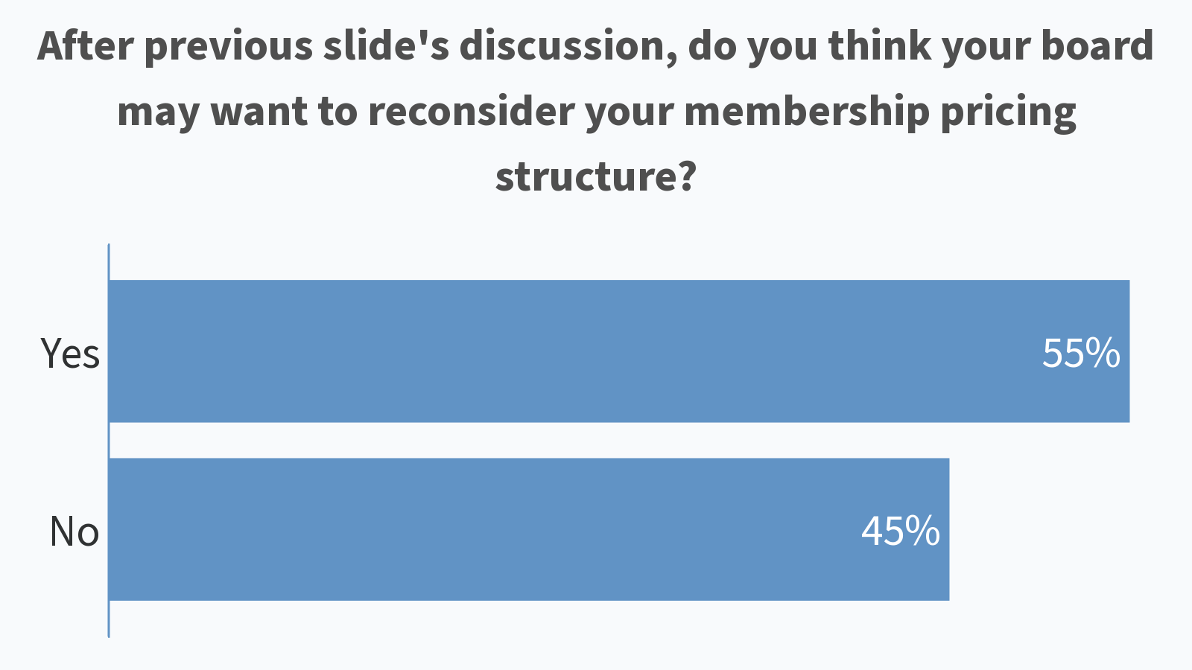

Slide 12
Additional Pricing Offers
Students
Gov’t / law enforcement
Newly certified CFEs
New ACFE members
Lifetime member awards
Activity point systems

Slide 13

Roundtable Discussions
Break until 11:10 CST
Discussions until 11:40 CST
Instructions

Slide 14

Wrap Up
Group highlights
Tomorrow’s Chapter Leader Meeting:
  Looking Past COVID-19: Events
Survey

Slide 15
Looking Past COVID-19:
Events
Chapter Leaders Meeting
Matt Molchany and James Rumph
ACFE Chapter Leaders Committee

Slide 16
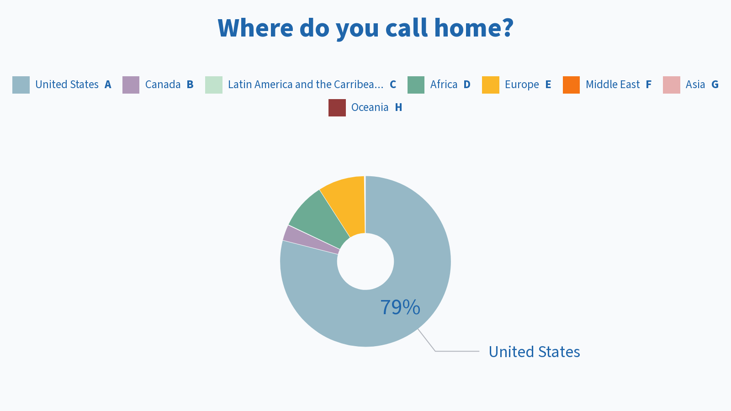

Slide 17
Agenda
Presentation/Discussion (10:00 – 11:00 AM CST)
  Evolution
  Event Options
  2020 Virtual Events
  Hybrid Tips
  Surveys
Roundtable Discussions (11:10 – 11:40 AM CST)
Discussion Recap (11:40 – 11:50 AM CST)

Slide 18
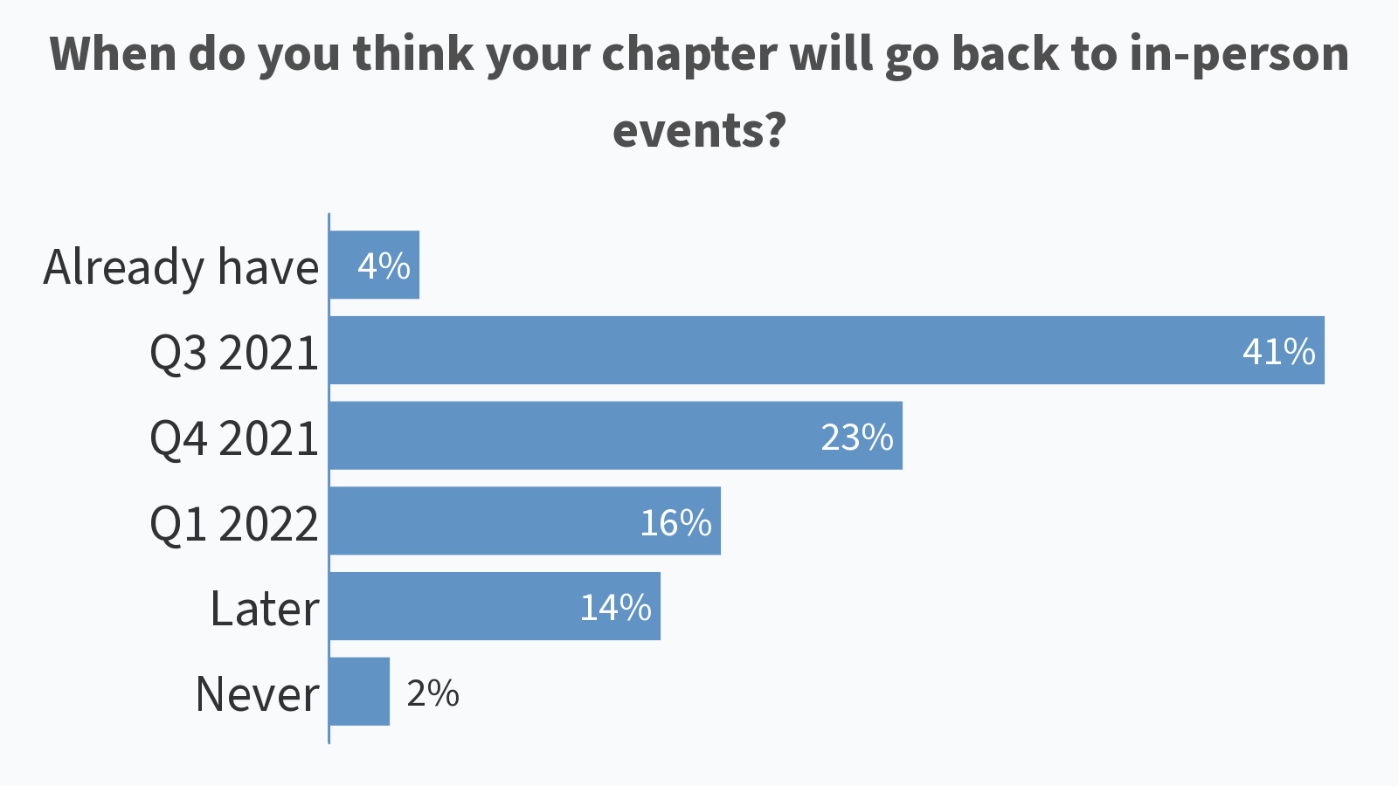

Slide 19
Evolution
Physical Events
Virtual Events
Hybrid Events
Pre-COVID
COVID
Post-COVID
Physical Events
Virtual Events

Slide 20
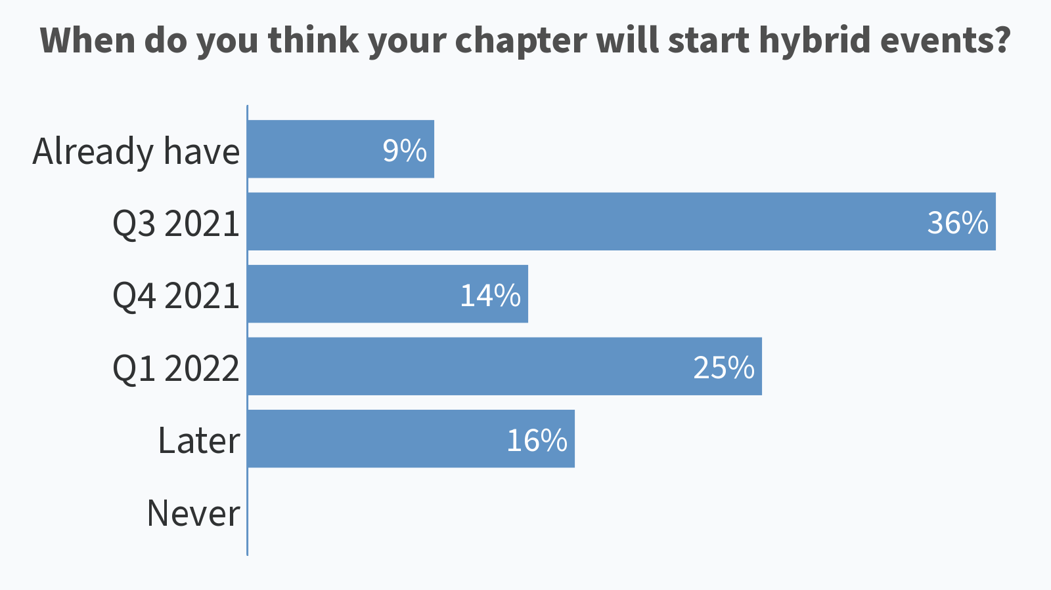

Slide 21
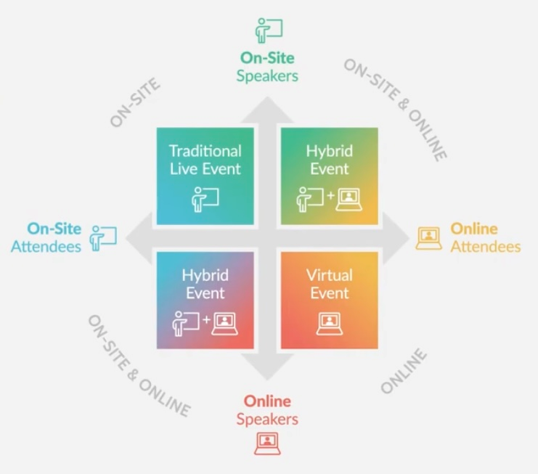
Event Options
Hybrid Options
Synchronous: All attendees experience content at same time
On-Demand: Content available after the physical event takes place
Partial Hybrid: Selected portions of event available simultaneously

Slide 22
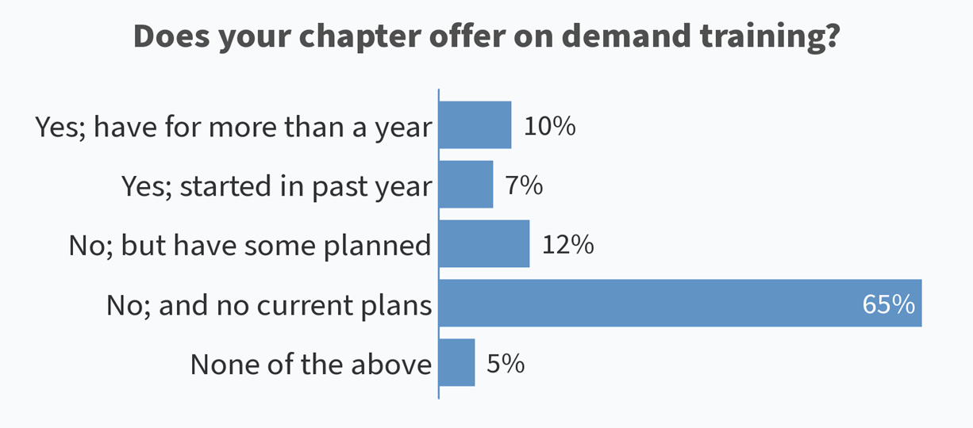

Slide 23
2020 Virtual Events
Of the 99 responses from Leader Survey, only 8 stated they didn’t transition to virtual events
  Any leader from that group want to discuss further?
Virtual Meeting Platform
  76 - Zoom
  18 - Teams
  8 - Webex
  7 - Go to Meeting
  2 - Skype
Collaboration with Other Chapters
  Any leader who collaborated with other chapter want to share experience

Slide 24
Hybrid Tips
Remember you are planning multiple unique events – not just one. There will be more decisions and complexity.
Create a staffing plan that caters to attendees without overtaxing your team.
Hire a team with live stream experience (e.g., as Maryland Chapter did). Don’t underestimate A/V production needs.
Choose a virtual platform that takes your live stream and creates a true experience for virtual attendees.

Slide 25
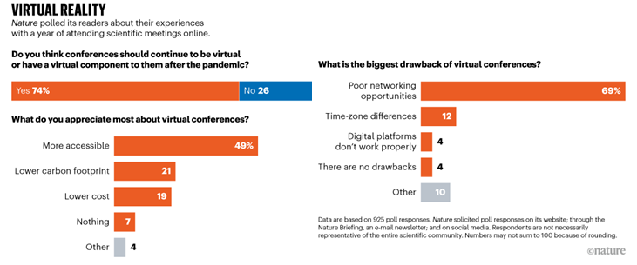
Nature Survey
⁽¹⁾ Scientists want virtual meetings to stay after the COVID pandemic. Nature. March 2, 2021. https://www.nature.com/articles/d41586-021-00513-1.

Slide 26
May 2021 Survey: Central Ohio Chapter Conference
“I had been going to the in-person conference for years. I got as much out of the virtual conference as I did in the in-person conference. In fact, in some ways, the virtual conference was a better experience. In the Convention Center, if you're in the back of the ballroom, it's hard to see the speaker. That wasn't a problem here. Next, what you're wearing doesn't matter. No need to make a good impression. Finally, no need to fight traffic and pay for parking.”
“I will be disappointed if it isn't available virtually next year. Not because of COVID but because I live [out of state] and I don't know that my company would pay for me to travel to OH.”
“I found it better because I don't have to hassle with getting there and back, moving between rooms and being distracted by others. I could also see all the presentations--sometimes when it is live it can be difficult to see the projection.”
“The virtual format allowed me to participate…I value in person events, too, so I understand that a return to in person is a serious consideration for the chapter. Maybe every other year offer a virtual alternative?”
“I prefer the virtual conference rather than the in-person conference that I attended in 2019. I received all information that was presented without interruptions and distractions from other attendees.”
2022 Attendance Preference

Slide 27
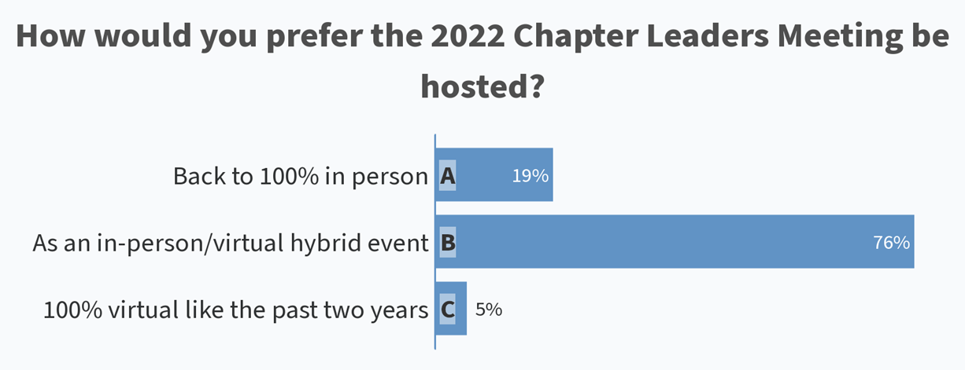

Slide 28
Roundtable Discussions
Break until 11:10 CST
Discussions until 11:40 CST
Instructions

Slide 29
Wrap Up
Group highlights
Survey

