Slide 1
Facilitating Virtual Chapter Presentations Chapter Leaders Meeting
Evan Lemoine and James Rumph
ACFE Chapter Leaders Committee

Slide 2
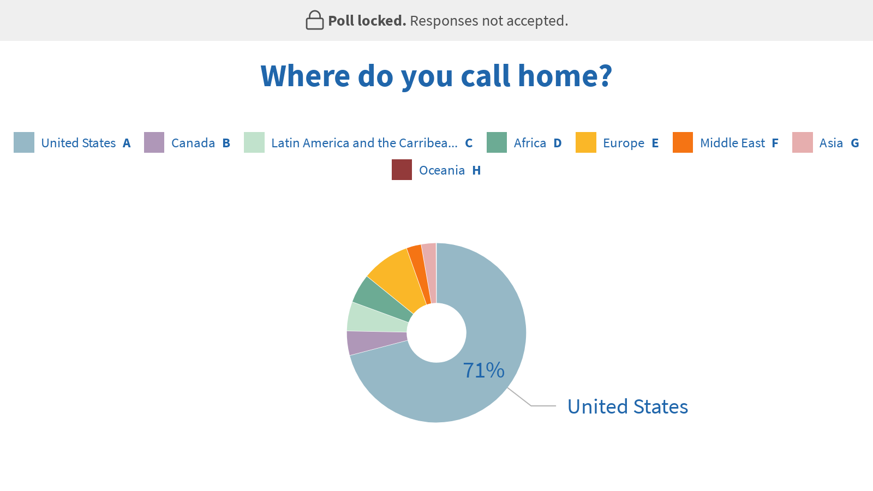

Slide 3
Facilitating Virtual Chapter Presentations
Presentation (60 min.)
COVID-19 Demand
Pre-Event
Initial Considerations
Platform selection
Speaker Instructions
Technical Test Sessions
Attendee Instructions
Event
Post-Event
Break (10 min.)
Collaboration Break Out (30 min.)
Wrap Up (10 min.)
Resources
Tomorrow: Retaining Members

Slide 4
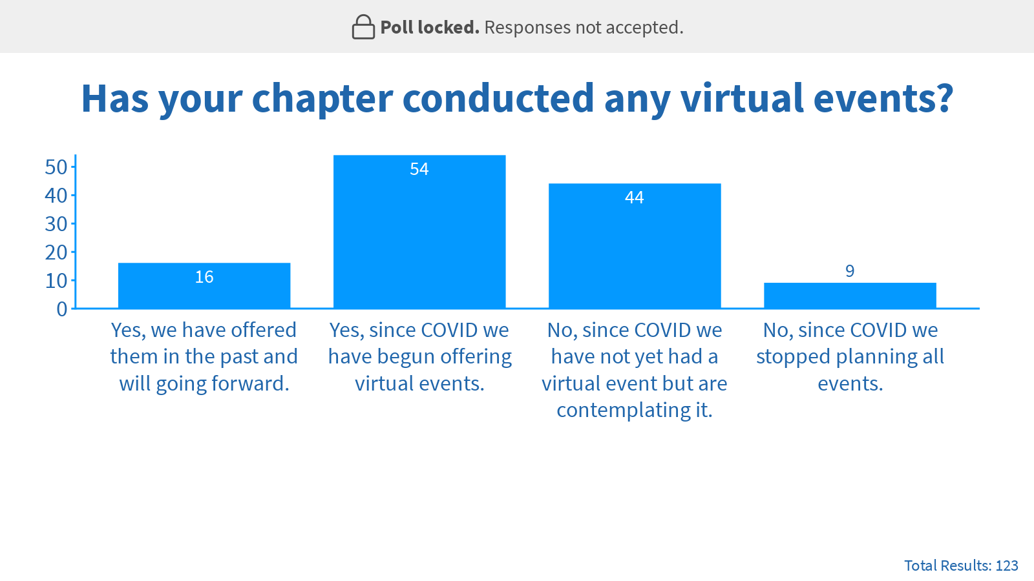

Slide 5
COVID-19 Demand

Slide 6
Pre-Event Initial Considerations
Speaker selection
Length
Scheduling
Video
Recording
Collaboration break out(s)
Pricing

Slide 7
Pre-Event Platform Selection
Integrated Features:
Platform | Required Host Software | Event Passwords | Virtual Backgrounds | Breakout Rooms | Polling | Attendee Text Chat | Resource Section
Meet | No | Yes | No | No | No | Yes | No
On24 | No | Yes | No | Yes | Yes | Yes | Yes
Remo | No | Yes | No | Yes | No | Yes | No
Skype | Yes | Yes | No | No | No | Yes | No
Teams | Yes | Yes | Yes | Yes | Yes | Yes | No
WebEx | Yes | Yes | No | Yes | Yes | Yes | Yes
Zoom | Yes | Yes | Yes | Yes | Yes | Yes | No

Slide 9
Pre-Event Speaker Instructions
Approach:
Question Approach
Recording
Resources
Video:
Location
Camera Angle
Wired Ethernet
VPNs/Firewalls

Slide 11
Pre-Event Technical Test Sessions
Simulate “live” event
Test all slide features
Test all platform features
Make sure presenter is comfortable with technology and roles

Slide 12
Pre-Event Attendee Instructions
Link
Best supported browsers
Test system capabilities ahead of event
Join event early

Slide 13
Event Housekeeping
Platform features
Muting expectations
CPE requirements
Surveys inform
Managing distraction
Managing technical difficulties
Collaboration break outs
Notes:
CPE Notes:
- NASBA CPE are only given for the live webinar and you must participate in 75% of the polling questions to receive a certificate
- Attendance check three times every hour, with at least one check occurring at an irregular interval. In order to receive full credit, you must be in attendance for the duration of the webcast and respond to at least 75% of the attendance questions.
- Archive sign-in sheets to verify your CPE attendance in the event your CPE records are audited.
S13 – 03. Monitoring mechanism for group internet based programs. In addition to meeting all other applicable group program standards and requirements, group internet based programs must employ some type of monitoring mechanism to verify that participants are participating during the duration of the course. The monitoring mechanism must be of sufficient frequency and lack predictability to provide assurance that participants have been engaged throughout the program. If polling questions are used as a monitoring mechanism, at least three polling questions must be used per CPE credit hour. CPE program sponsors should verify with respective state boards on specific polling requirements.
https://www.nasbaregistry.org/impact-of-covid-19

Slide 14
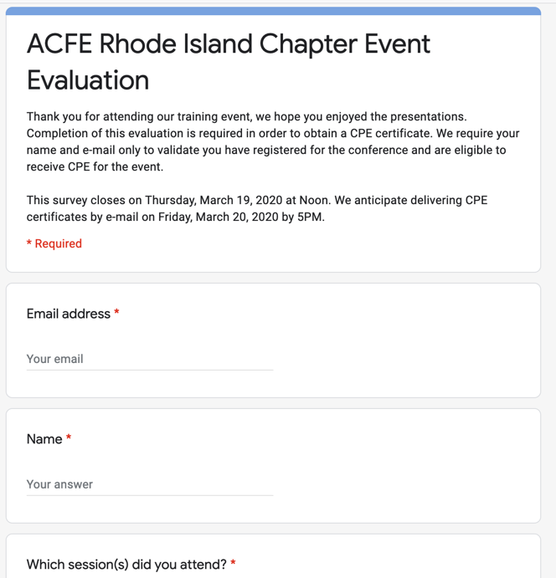
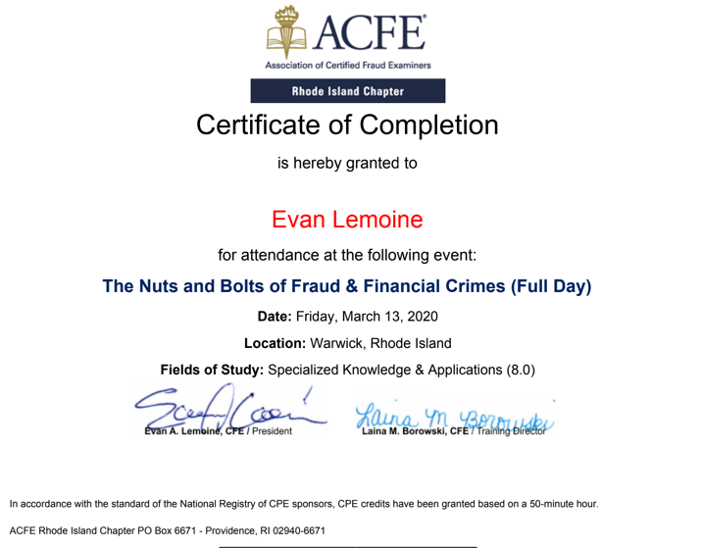
Post-Event
Surveys and Feedback
Continuing Education Credit
Continuous Improvement

Slide 15
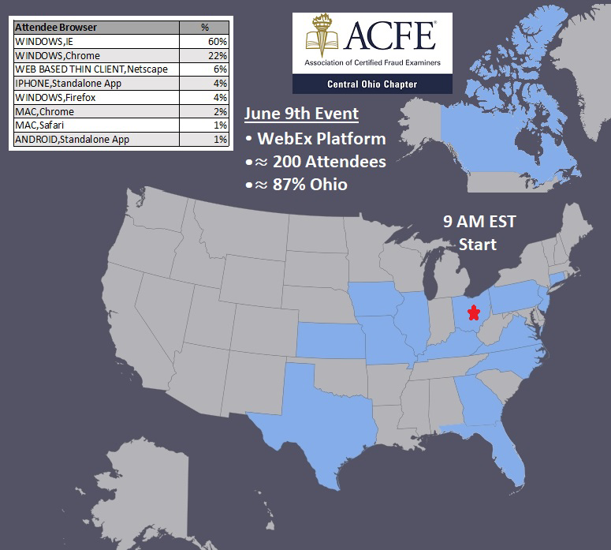
Post-Event Data Analysis

Slide 16
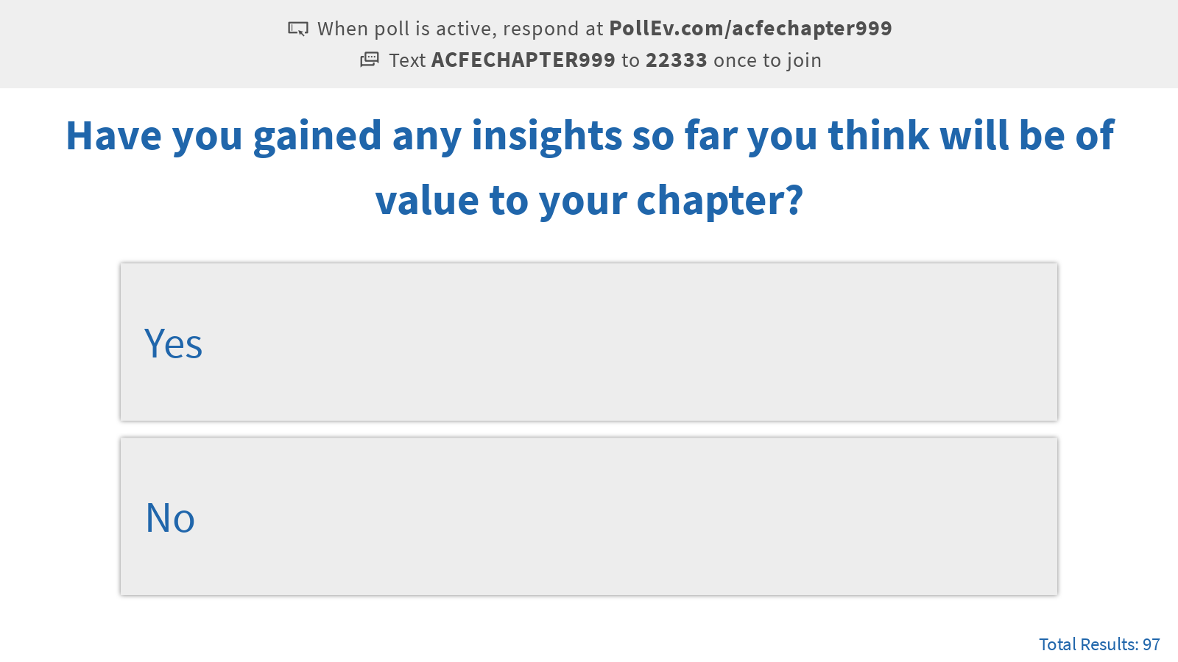

Slide 17
Collaboration Break Out
Instructions

Slide 18
Wrap Up
Group highlights
Tomorrow’s Chapter Leader Meeting:
Retaining Chapter Members During COVID-19
Survey

Slide 19
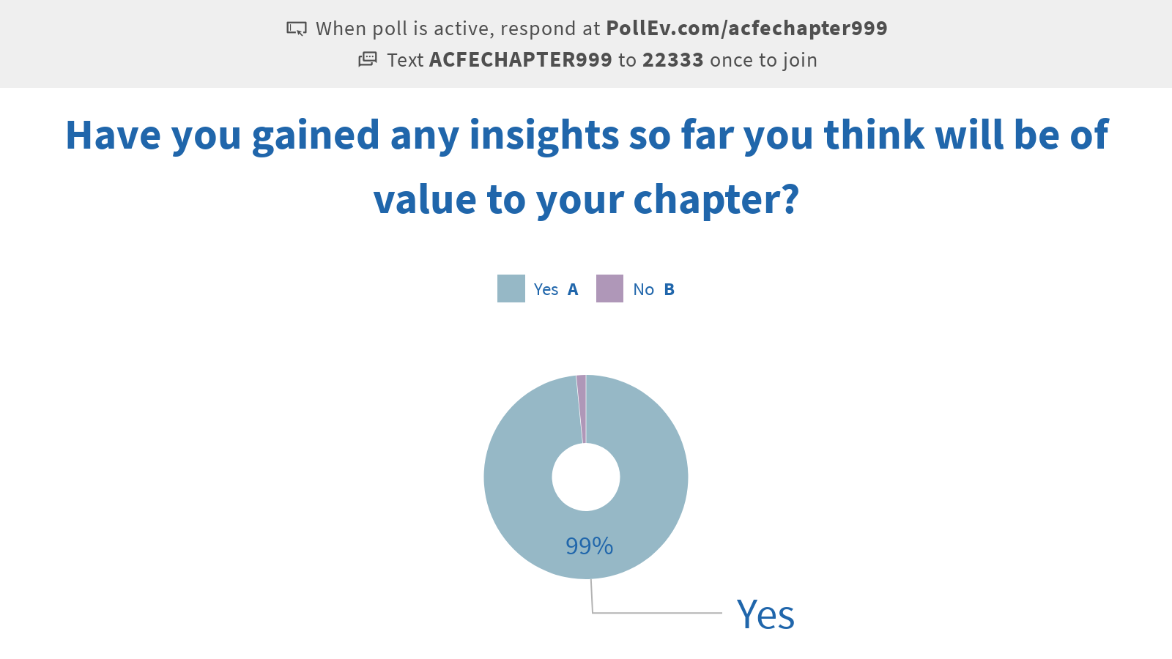

Slide 20
Resources
Example ACFE speaker agreement (includes film/record and broadcast language)
Example ACFE seed questions
National Registry of CPE Sponsors: Impact of COVID-19; NASBA; https://www.nasbaregistry.org/impact-of-covid-19

Slide 21
Retaining Members During COVID-19 Chapter Leaders Meeting
Evan Lemoine and James Rumph
ACFE Chapter Leaders Committee

Slide 22
Retaining Members During COVID-19
Presentation (60 min.)
Customer Acquisition vs. Retention Costs
COVID-19 Challenges
On-Boarding
Recognition & Reward
Communication
Surveys
Break (10 min.)
Collaboration Break Out (30 min.)
Wrap Up (10 min.)
Resources

Slide 23
Notes:
(

Slide 24
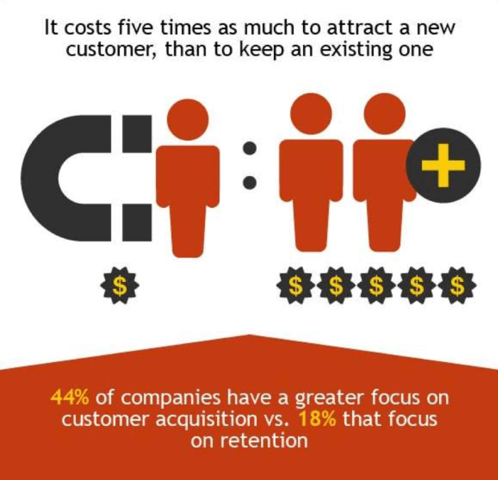
Customer Acquisition vs. Retention Costs
Don't Spend 5 Times More
Attracting New Customers,
Nurture The Existing Ones

Slide 25
COVID-19 Challenges

Slide 27
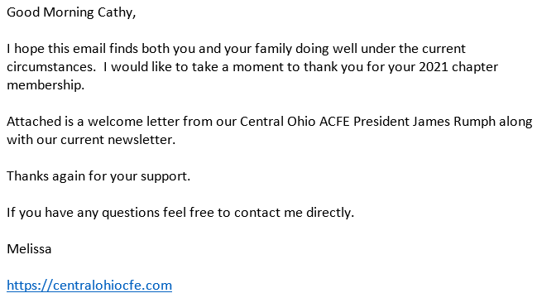
Onboarding Welcome Emails
Personalized email
Signed letter
Notes:
Sending personalized e-mails helps attaches a person to it to reach out to.
Many organizations uses some association management system, it can also mean updating “who” is sending those messages and that customized messages are updated annually.

Slide 28
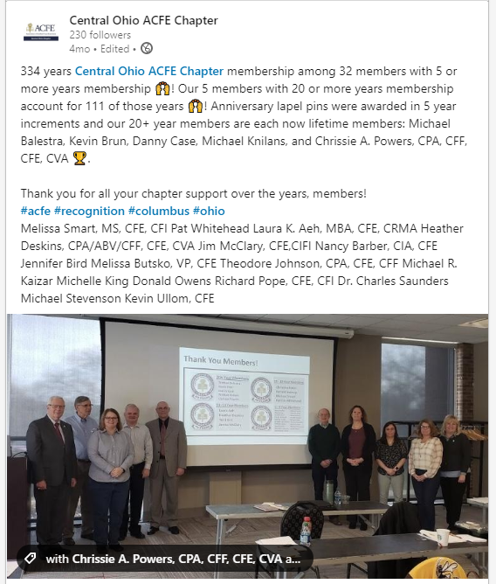
Recognition & Reward
Membership Years
Example:
Lapel pins given to recognize in 5 year increments
Recognized at chapter event and on social media
Lifetime membership awarded to 20+ year members

Slide 29
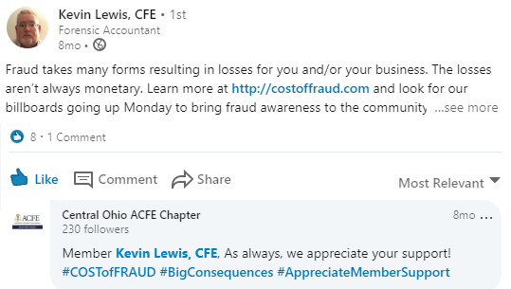
Recognition & Reward Other Public Appreciation

Slide 30
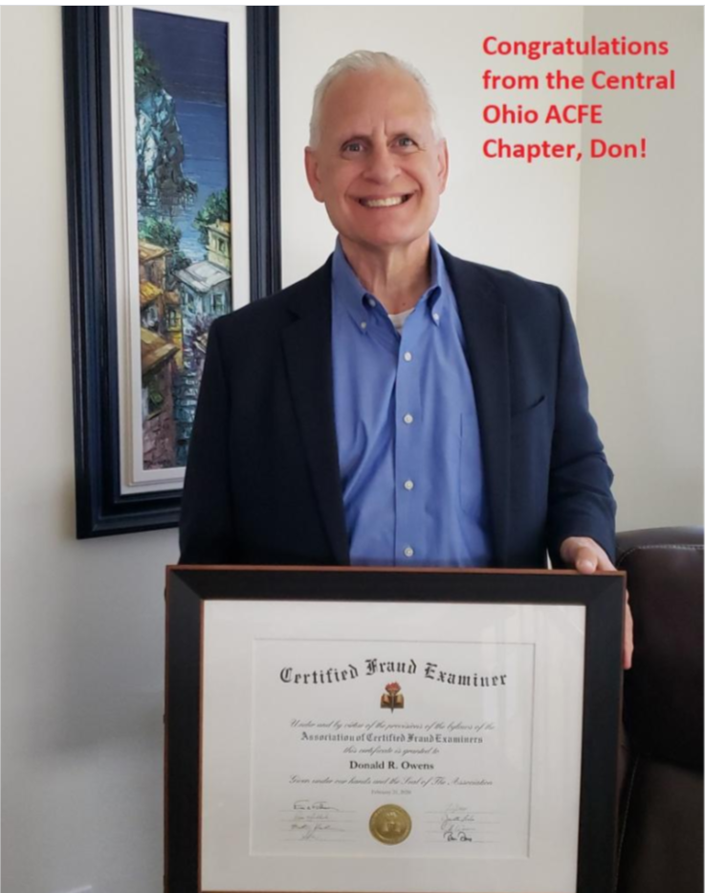
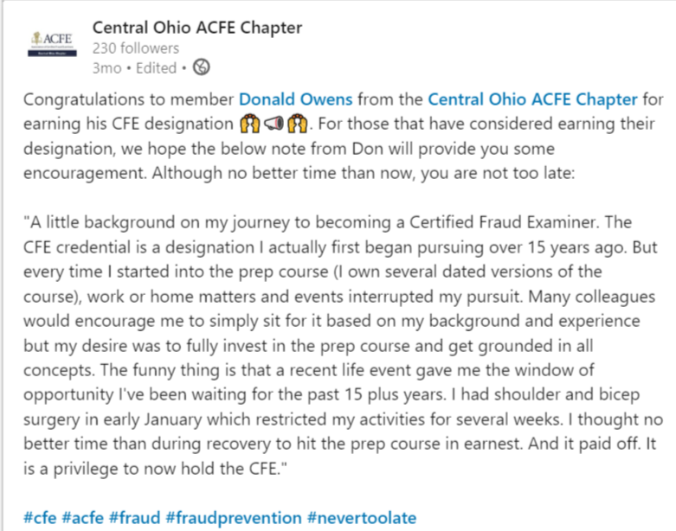
Recognition & Reward Earning CFE
Newsletters
Social media posts

Slide 31
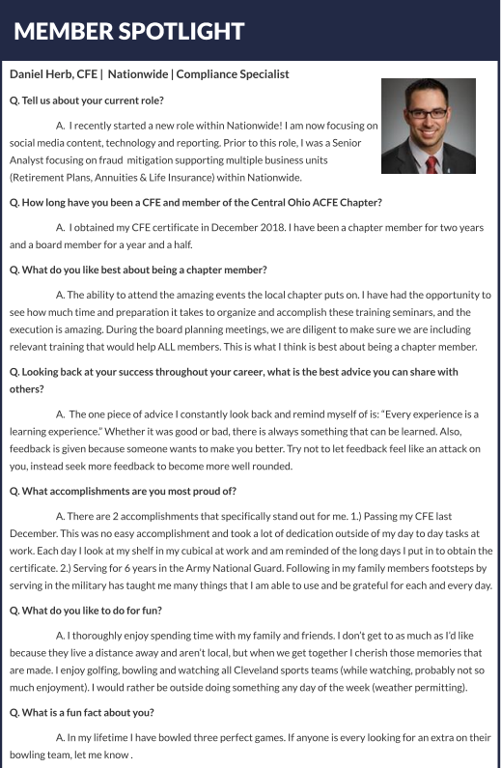
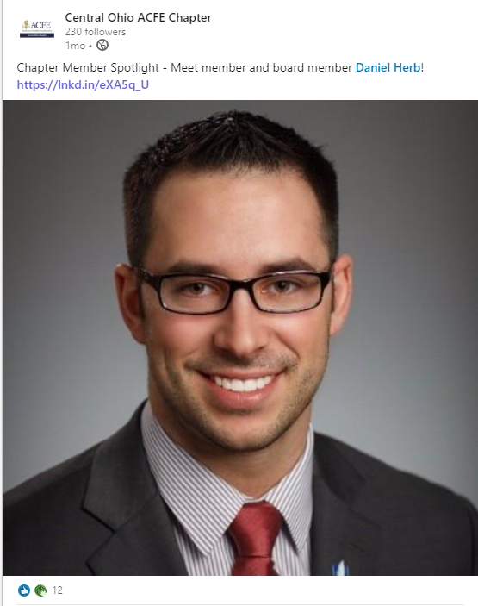
Recognition & Reward Member Spotlights
Newsletters
Social media posts
Website

Slide 32
Recognition & Reward Member Point System
Members receive points for:
Attending training events
Referring a new member
Following/posting on social media
Volunteering

Slide 33
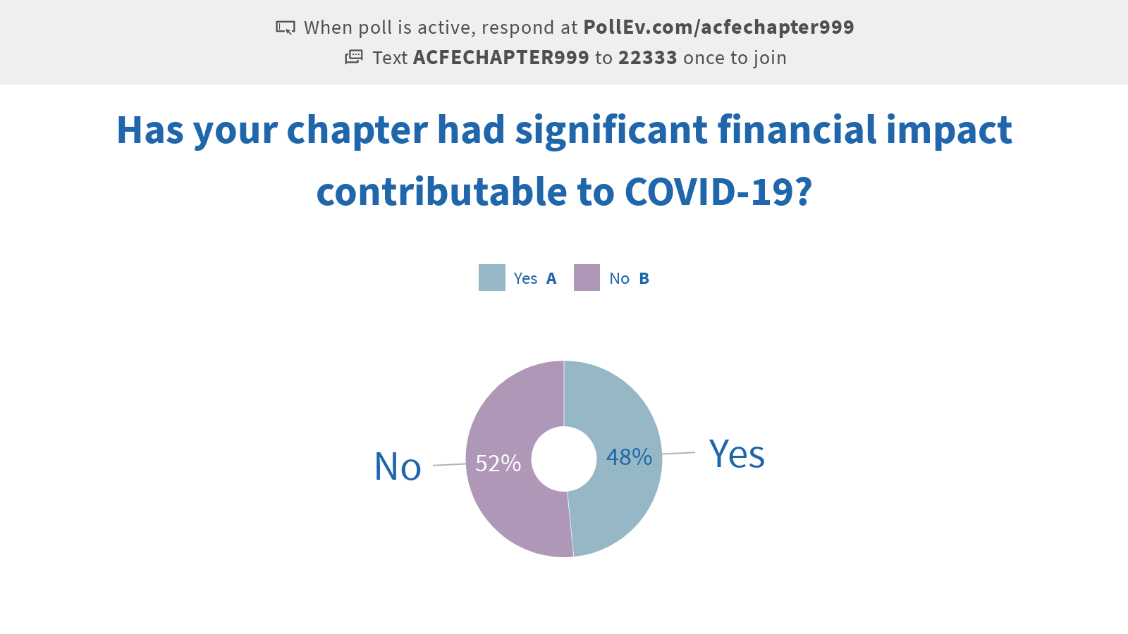

Slide 34
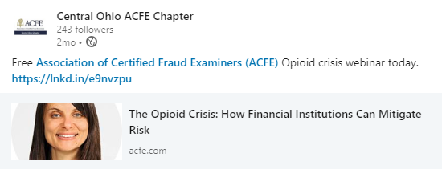
Communication Share Other Training
Help make sure members have plenty of training opportunities

Slide 35
Communication Share ACFE Resources

Slide 36
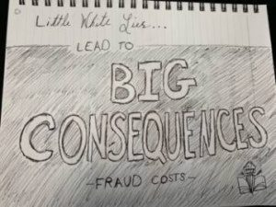
Communication Public Awareness Campaign
Think Tank
Billboards
Social Media
Proclamations
Articles

Slide 37
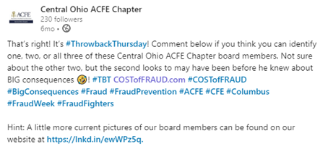
Communication Fun
Rough Monday Morning?
Taco Tuesday
Board Member #TBT

Slide 38
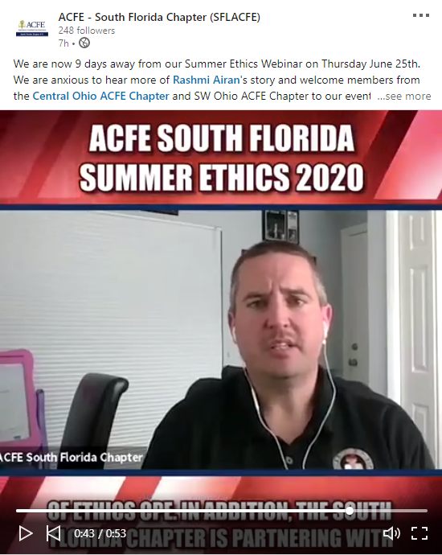
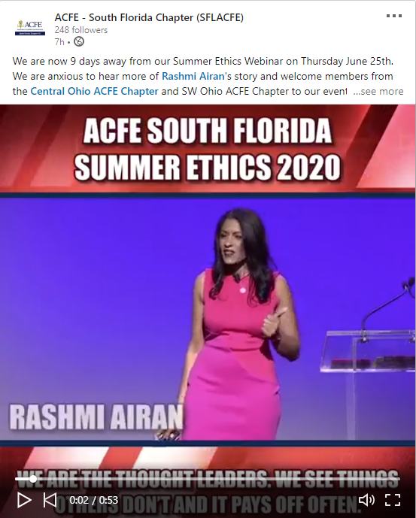
Communication Videos

Slide 39
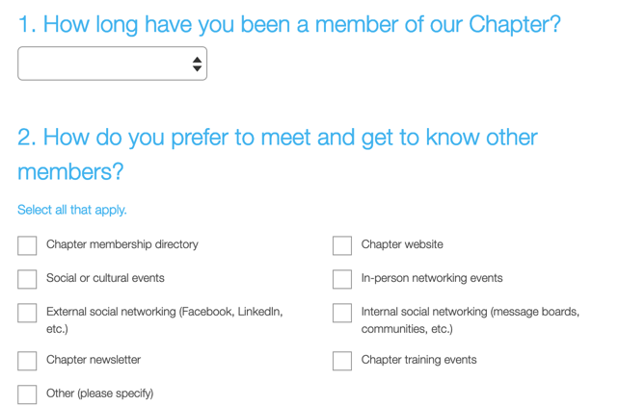
Surveys Expectations vs. Experience

Slide 41
Collaboration Break Out
Instructions

Slide 42
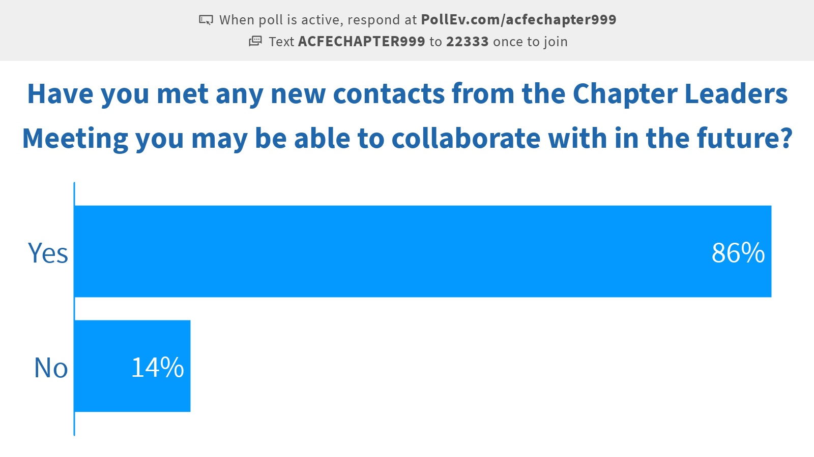

Slide 43
Wrap Up
Group highlights
Survey
Notes:
?
10 minutes

Slide 44
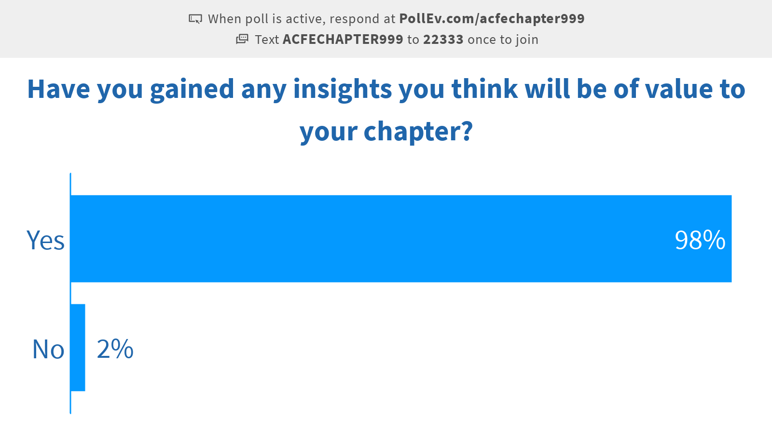

Slide 45
Resources
Don't Spend 5 Times More Attracting New Customers, Nurture The Existing Ones; Forbes; https://www.forbes.com/sites/jiawertz/2018/09/12/dont-spend-5-times-more-attracting-new-customers-nurture-the-existing-ones/#1efff46c5a8e
Cost of Fraud public awareness campaign website; CostofFraud.com

