Slide 1
Chapter Leaders Meeting
2018 Year in Review
Steve Wilson, CFE
Vancouver, Canada Chapter

Slide 2
Chapter Leaders Committee
Jackie L. Walter
Chelsea Binns
Nicole Biskop
Jaco De Jager
James Fellin
Ryan C. Hubbs
Robert Kilian
Steve Wilson
Evan Lemoine
ACFE Staff
Joey Broccolo
Tim Harvey
Ross Pry

Slide 3
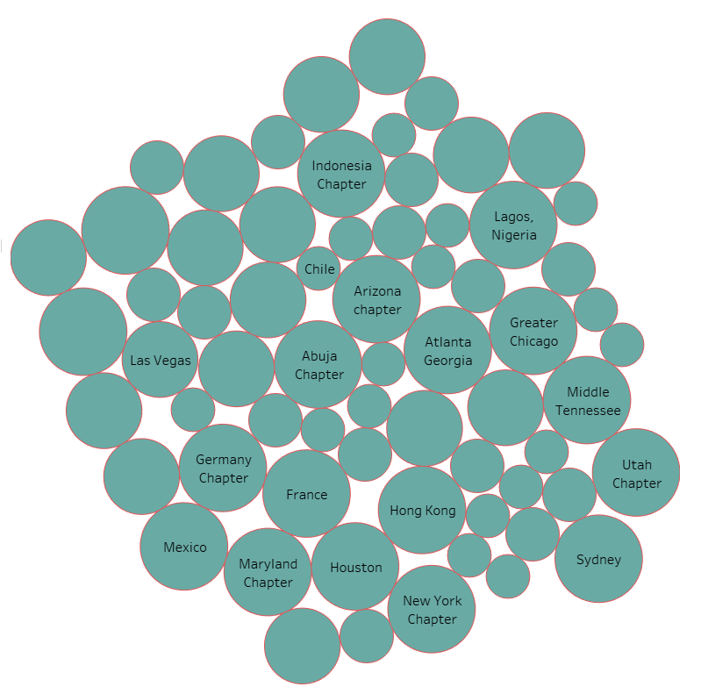
Survey Stats - Chapters
477 Officers
66 Chapters
309 Years of Service
7975 Chapter Members
334 Events / Year
76% Membership Fee
$35 US Average Fee

Slide 4
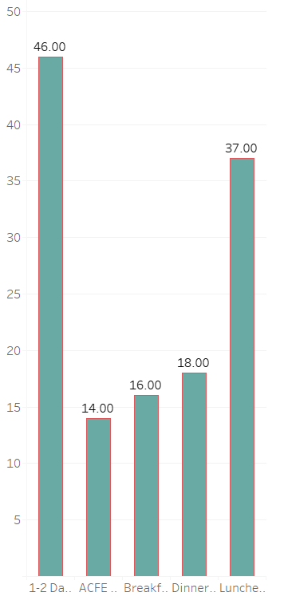
Survey Stats - Chapters
Chapter Training Events by Type
46 1-2 Day Conferences
14 ACFE Onsite Training
16 Breakfast Meetings
18 Dinner Meetings
37 Luncheon Meetings

Slide 5
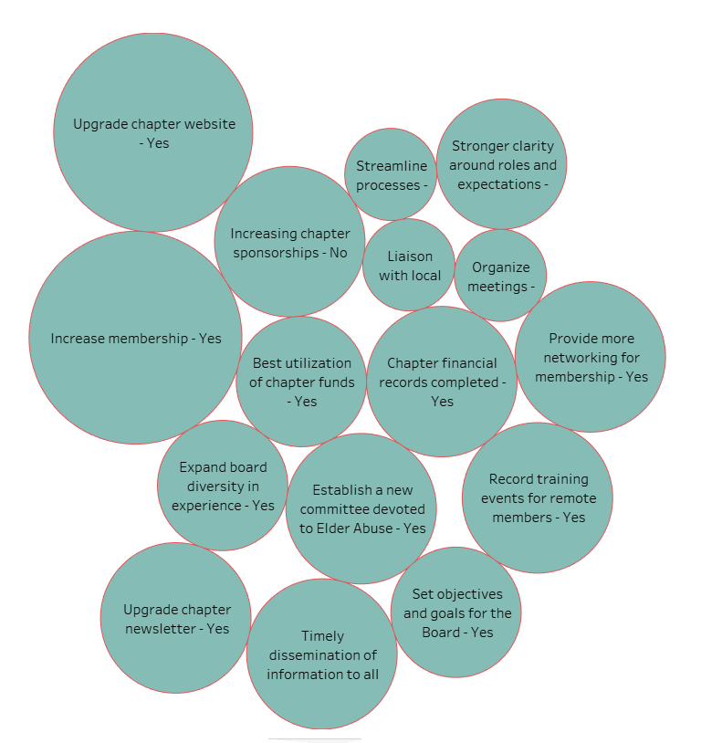
Chapter Goals
Top Goals Achieved
Increased membership
Upgrading Website
Two Goals Not Achieved
Chapter Sponsorship
Board Members Duty Review

Slide 6
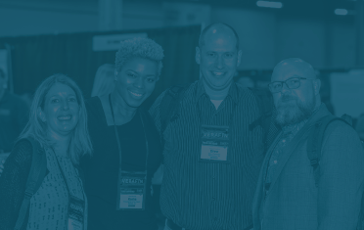
Greatest Achievements
Local Chapter Conferences
Growing the Membership
Donation to ACFE Foundation
Consistency with Meetings
New Website
Student Membership

Slide 7
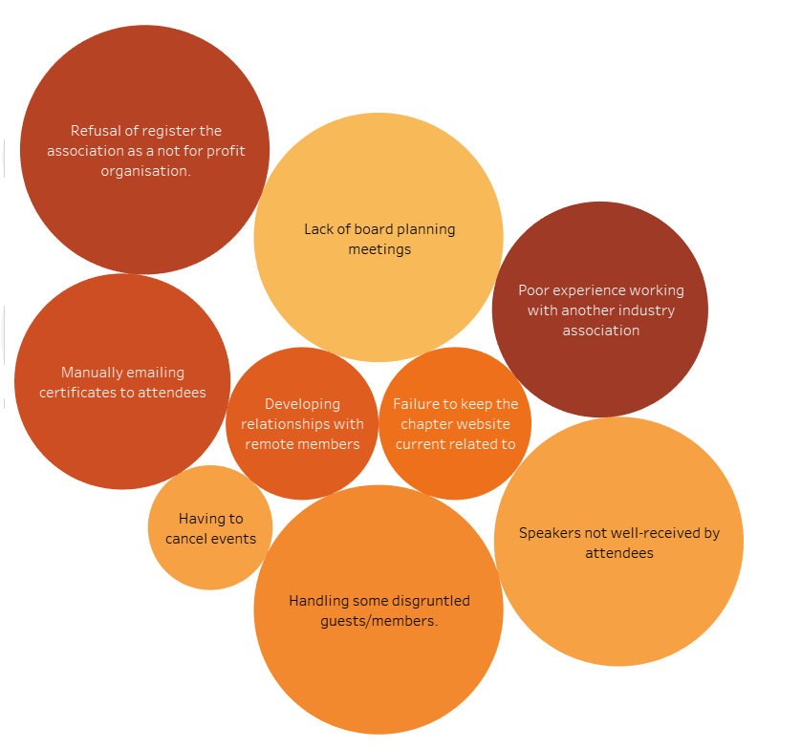
Setbacks / Challenges
Speaker Issues
Lack of Planning
Cancelled Events
Disgruntled Guests
Partnership Issues
Remote Members
Website Issues

Slide 8
Factors Causing Challenges
Lack of Communication
No Due Diligence
Geographical Distance
Poor Weather
Speaker Going Off-Track
No Proper Governance

Slide 9
What Was Learned?
Communicate and Follow Up
Ask for References and Outline From Speakers
Meeting Available Online and Locally
Discuss Cancellation Plan with Board

Slide 10
What Was Learned?
Mandatory Planning Meeting Every Year
Document all Discussions and Decisions
Clearly Outline Partnership and Expectations
Policies Regarding Website Access and Updates
Proper Governance for Chapters

Slide 11
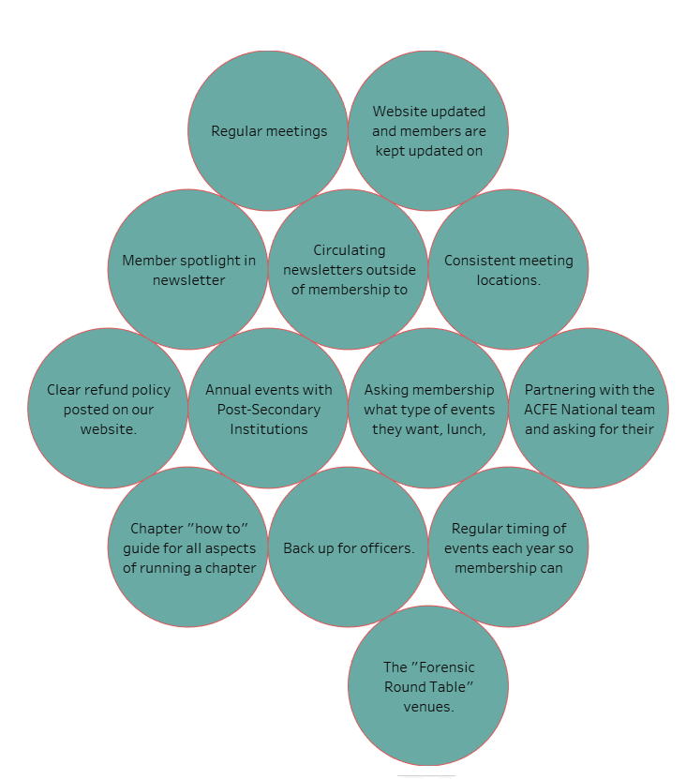
Your Best Practices

Slide 12
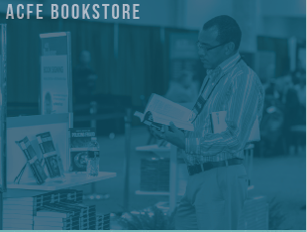
Top Challenges for Chapters
Interesting and Relevant Speakers
Organizing Events
Overall Growth
Membership Participation
More Students Involved
Chapter Finances
Obtaining Sponsors

Slide 13
Top Challenges for Chapters
Retaining Membership
Expectations of Board Members
ACFE Global Members at Local Events
Increasing Membership
Several Common Themes

Slide 14
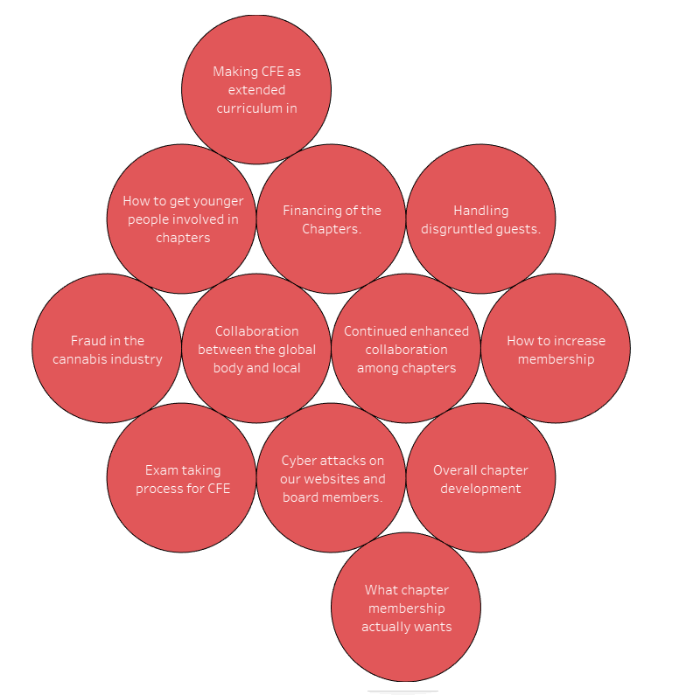
Hot Topics For Discussion
Common Themes Again
Cyber Risk
New Technology
Chapter Collaboration
CFE Exam Process
Overall Development
ACFE Innovation

Slide 15
Thoughts / Discussions

Slide 16
Looking Ahead

Slide 17
Chapter Leaders Meeting
2018 Year in Review
Steve Wilson, CFE
Vancouver, Canada Chapter
Thank you for your time

