Slide 1
Chapter Leaders Meeting
Policies and Procedures
Evan A. Lemoine, CFE, CPA, CGMA, PRP, MBA President, ACFE Rhode Island Chapter #33

Slide 2
Overview
Understanding you, the officer
Understanding your chapter
Discuss questions and problems openly and freely

Slide 3
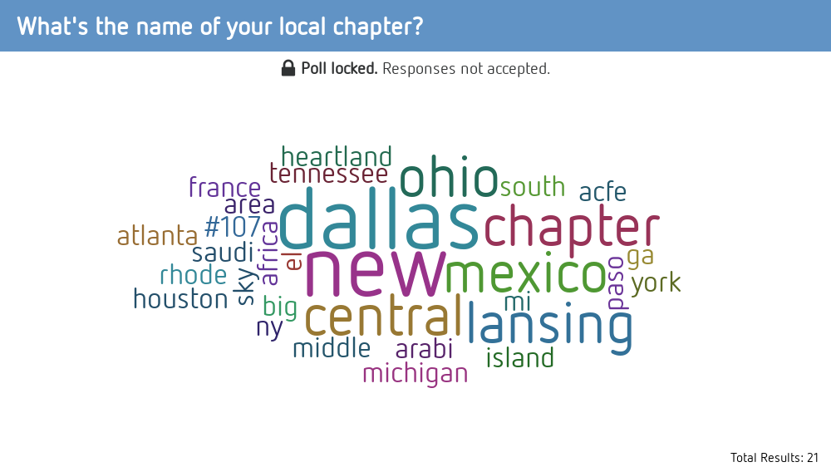
Notes:
What's the name of your local chapter?
https://www.polleverywhere.com/free_text_polls/biYR3XkqWCVDX4zv4x4wa

Slide 4
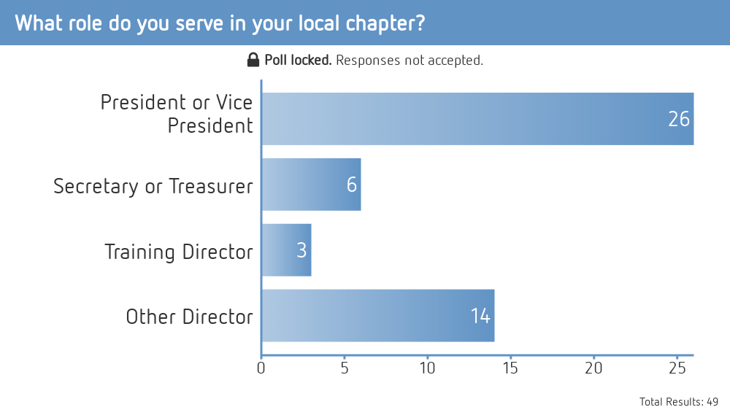
Notes:
What role do you serve in your local chapter?
https://www.polleverywhere.com/multiple_choice_polls/knQJVTRgvsCT0wo6AP0vs

Slide 5
Overview
Past
Historical records (accounting / financial, document retention, attendees at meetings)
Bylaws and other governing rules and procedures

Slide 6
Overview
Present
Website / E-mails
Financial review / audit committee
Payment/refund policies
Code of Conduct
Issuing CPE Certificates
Networking events vs. training events

Slide 7
Overview
Future
Officer fatigue
Succession of officers
Strategic planning and officer training
Membership recruitment

Slide 8
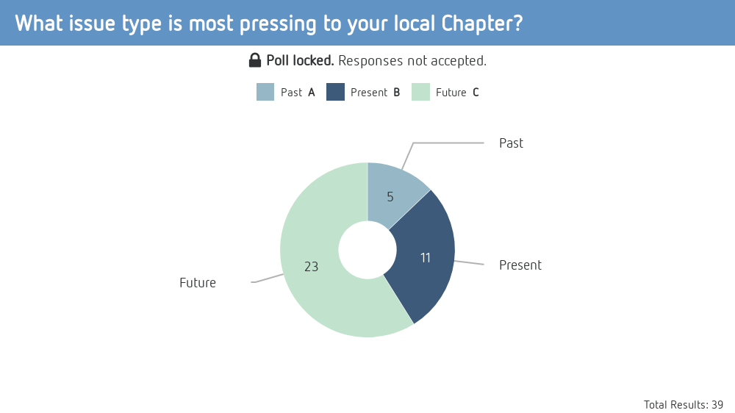
Notes:
What issue type is most pressing to your local Chapter?
https://www.polleverywhere.com/multiple_choice_polls/tdDC5hkaygHKfTTP7Cpeq

Slide 9
“Past” Issues
Bylaws
What do our existing rules say?
Document Retention
Attendees sign-in sheets at meetings
Annual financial reports by treasurer
Report of any audit or financial review committee

Slide 10
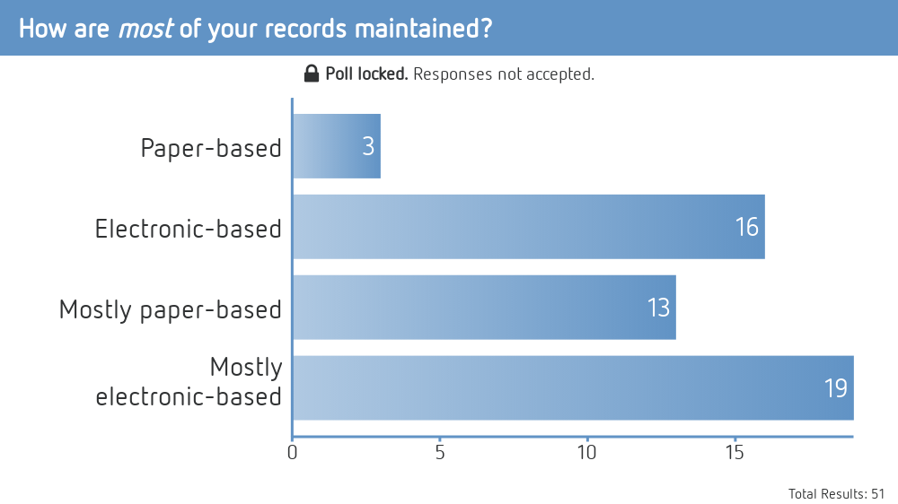
Notes:
How are most of your records maintained?
https://www.polleverywhere.com/multiple_choice_polls/ZZoPJgmmyInvLRITUrTsr

Slide 11
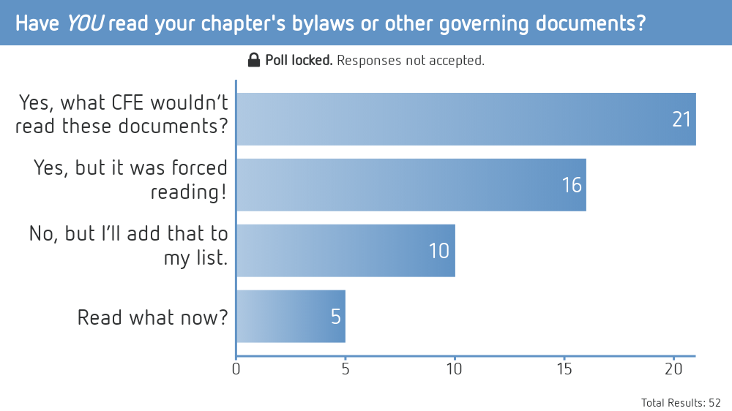
Notes:
Have YOU read your chapter's bylaws or other governing documents?
https://www.polleverywhere.com/multiple_choice_polls/vwlwrUATWJKfZzkl75tmL

Slide 12
“Past” Issues
Bylaws
What do our existing rules say?
Document Retention
Attendees sign-in sheets at meetings
Annual financial reports by treasurer
Report of any audit or financial review committee

Slide 13
Potential Solutions
Uniform Chapter Bylaws vs. Customized Rules
Document Retention Policy (trending “Current” issue)
Notes:
I recommend customized rules!

Slide 14
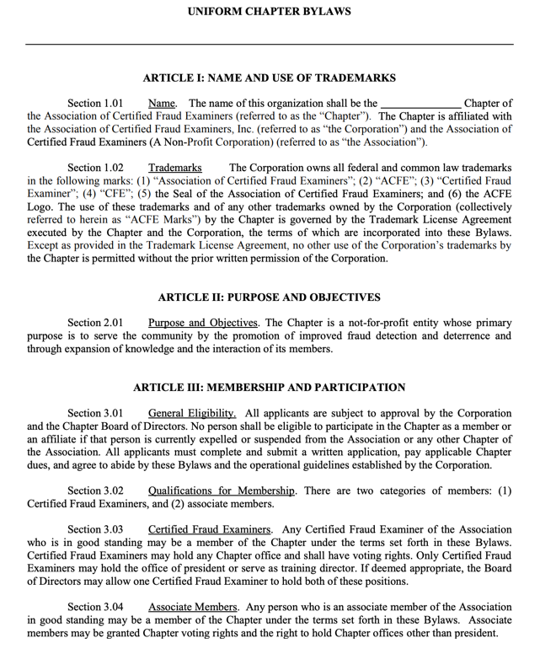

Slide 15
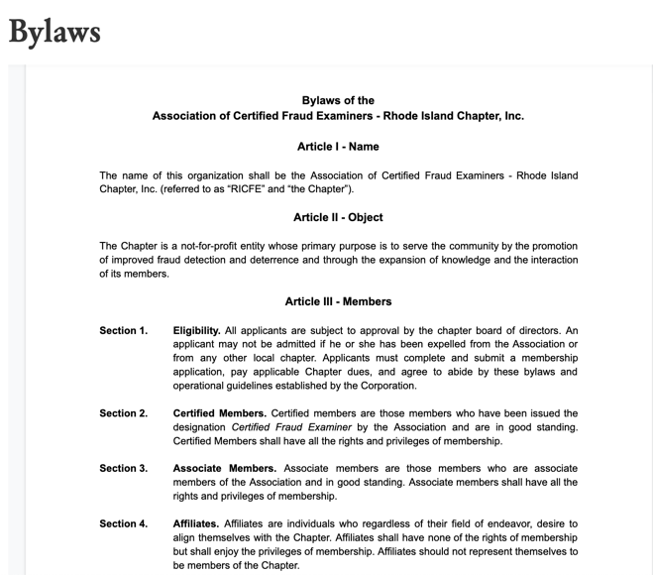
Customized Bylaws
Notes:
Our bylaws are available on our website if you’d like to review – at www.ricfe.org.

Slide 16
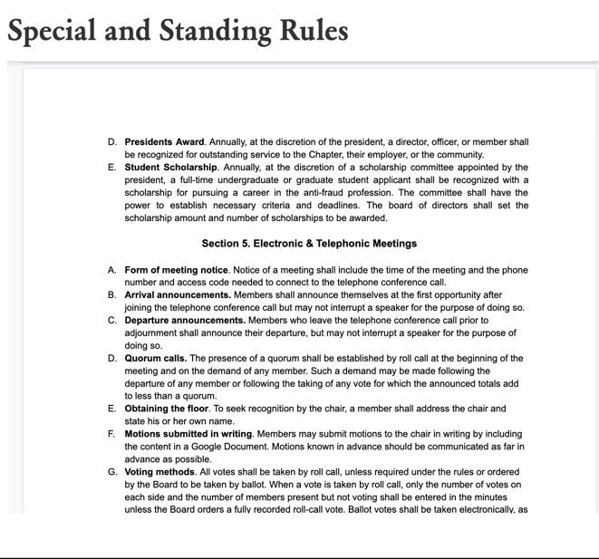
Customized Rules
Notes:
While our special and standing rules are accessible to members-only, if you contact me I can provide you these resources.

Slide 17
“Present” Issues
Managing “Cloud-based” Technology
Website, e-mail account(s), CPE certificates
Member-only functionality (e.g. voting, access-restricted content)
Document sharing between officers

Slide 18
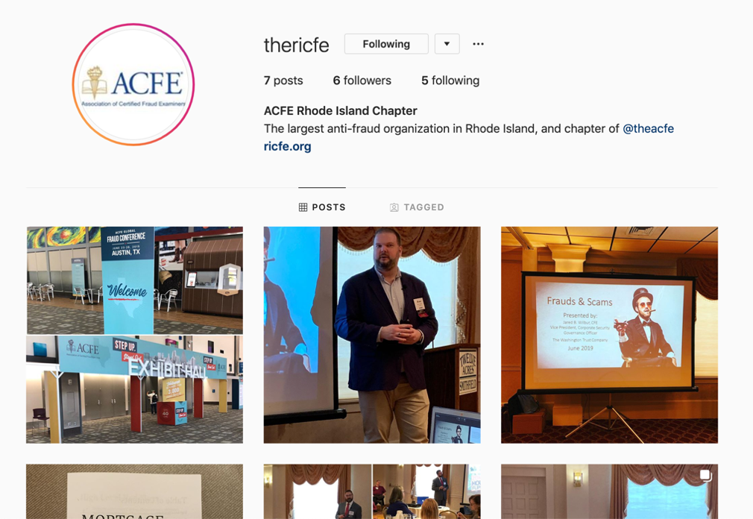
“Present” Issues

Slide 19
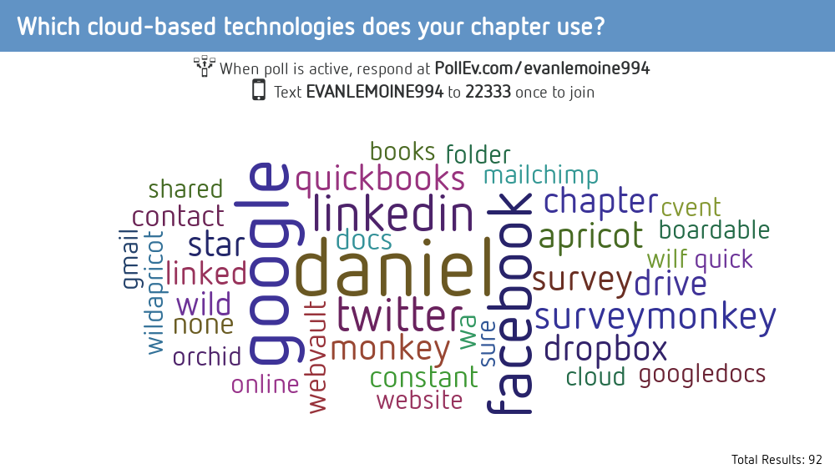
Notes:
What cloud-based technology does your chapter use?
https://www.polleverywhere.com/free_text_polls/vBgUlHHWJmvIDzpi1nKee

Slide 20
“Present” Issues
Managing “Cloud-based” Technology
Website, e-mail account(s), CPE certificates
Member-only functionality (e.g. voting, access-restricted content)
Document sharing between officers

Slide 21
“Future” Issues
Leadership & Membership
Community involvement and partnerships
Networking events
Membership recruitment
Officer fatigue / recruitment and succession planning

Slide 22
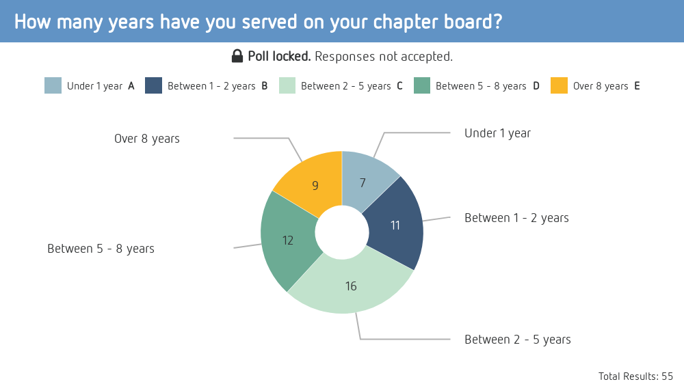
Notes:
How many years have you served on your chapter board?
https://www.polleverywhere.com/multiple_choice_polls/0aeMcgVX69g9eqCG3c2jb

Slide 23
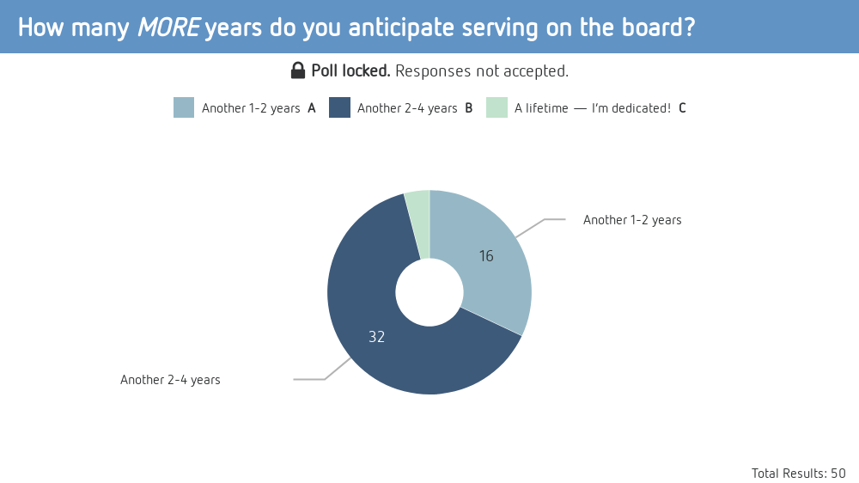
Notes:
How many MORE years do you anticipate serving on the board?
https://www.polleverywhere.com/multiple_choice_polls/6ZTI7ki45RytRPK0VyHTA

Slide 24
“Future” Issues
Leadership & Membership
Community involvement and partnerships
Networking events
Membership recruitment
Officer fatigue / recruitment and succession planning

Slide 25
Summary
“If you fail to plan, you are planning to fail.”
- BENJAMIN FRANKLIN
“Paper is to write things down that we need to remember. Our brains are used to think.”
- ALBERT EINSTEIN
“ .
”

Slide 26
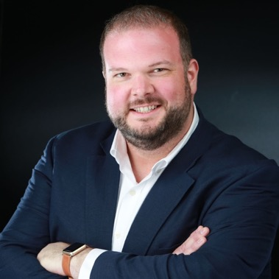
Questions?
Evan Lemoine, CFE President, ACFE Rhode Island
Evan.Lemoine@gmail.com

