Slide 1
Chapter Leaders Meeting
“Things That Go Wrong at Events and How to Avoid Them”
Dr. Chelsea Binns, President, New York Chapter #14

Slide 2
My experience with the ACFE/NYCFE
NY Chapter- NYCFE
ACFE
2018-Present: NYCFE Chapter President
2016-2018: NYCFE 1st Vice President and Training Director
2014-2016: NYCFE 2nd Vice President and Training Director
2012-2014: NYCFE Board Member at Large
2019-Present: ACFE Chapter Leaders Committee
2016-2018 ACFE Higher Education Committee
2011-Present: ACFE Advisory Council

Slide 3
Event Planning Experience
I have been involved of the planning process of more than 10 New York Chapter conferences since 2012.
Sample events include:
Fraud Investigation Trends, October 18, 2019
Fraud Resilience: Getting Ahead of a Threat, October 27, 2017
Future Fraud Trends: A Global Perspective, October 14-15, 2016
Investigations 2015: October 23-24, 2016
Global Fraud Trends, the Critical C’s: Compliance, Corruption and Cybercrime, October 17-18, 2014

Slide 4
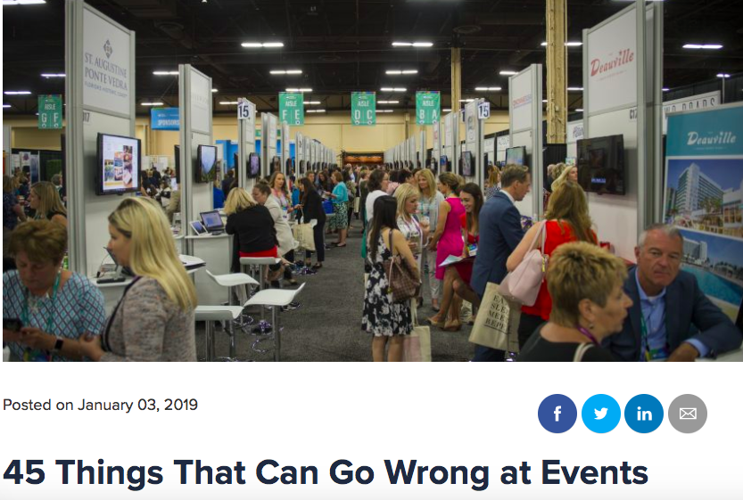
Inspiration
Source: Caroline Howard, CVENT
Notes:
In some capacity

Slide 5
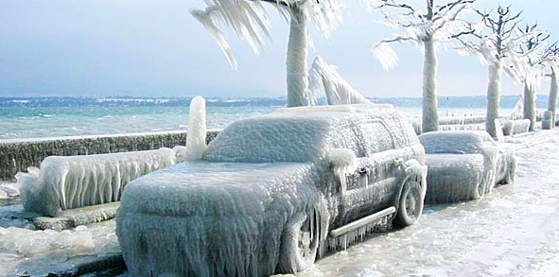
Things That Go Wrong at Events
Weather

Slide 6
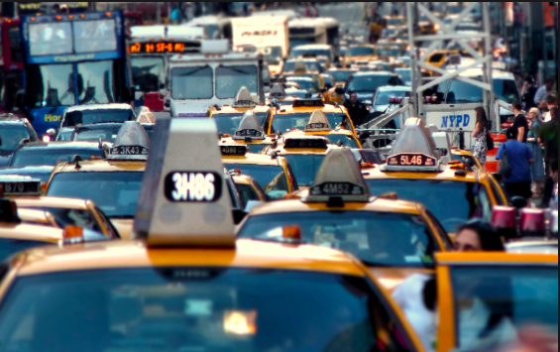
Things That Go Wrong at Events
Speaker gets stuck in traffic

Slide 7
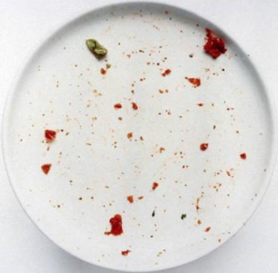
Things That Go Wrong at Events
Run out of food

Slide 8
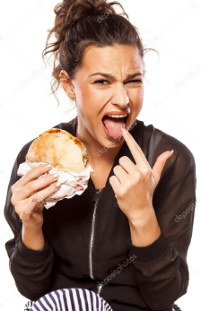
Things That Go Wrong at Events
Food does not meet expectations

Slide 9
Things That Go Wrong at Events
Forget to provide dietary options for food

Slide 10
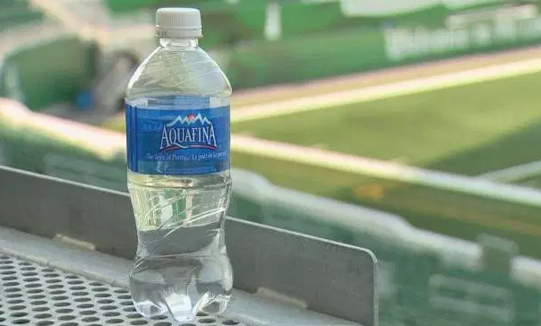
Things That Go Wrong at Events
Not enough water

Slide 11
Things That Go Wrong at Events
Speaker drops out last minute

Slide 12
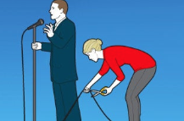
Things That Go Wrong at Events
Speaker content is poor (offensive, not funny, etc.)

Slide 13
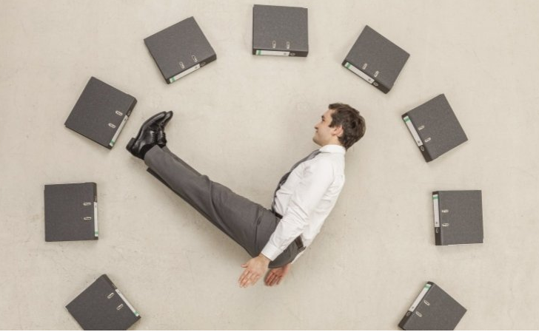
Things That Go Wrong at Events
Speaker goes over time

Slide 14
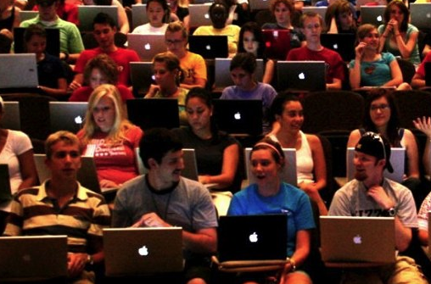
Things That Go Wrong at Events
Losing attendee attention

Slide 15
Things That Go Wrong at Events
Not enough break time between the segments

Slide 16
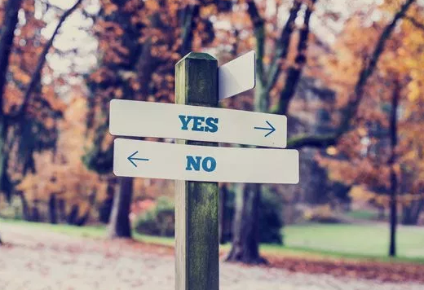
Things That Go Wrong at Events
More guests arrived than RSVP’d

Slide 17
Things That Go Wrong at Events
Guests arrive too early

Slide 18
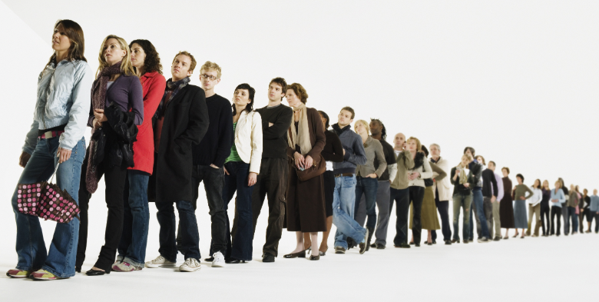
Things That Go Wrong at Events
Long lines

Slide 19
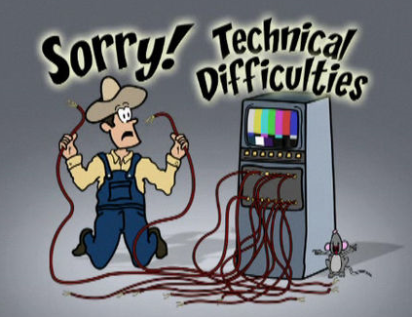
Things That Go Wrong at Events
Technical glitch

Slide 20
Things That Go Wrong at Events
More!
Theme fell flat
Not enough seats
Venue too hot/cold
Bathroom out of order
Power outage or similar issue
Stage not set up right
Event is short staffed
Road blockage leading to event

Slide 21
Things That Go Wrong at Events
Did I miss any?

Slide 22
Things That Go Wrong at Events
Thank you!
Dr. Chelsea Binns
Assistant Professor
CUNY John Jay College of Criminal Justice
President@nycfe.org
cbinns@jjay.cuny.edu

Slide 23
Chapter Leaders Meeting
“Things That Go Wrong at Events and How to Avoid Them”
Dr. Chelsea Binns, President, New York Chapter #14

